Slide 1
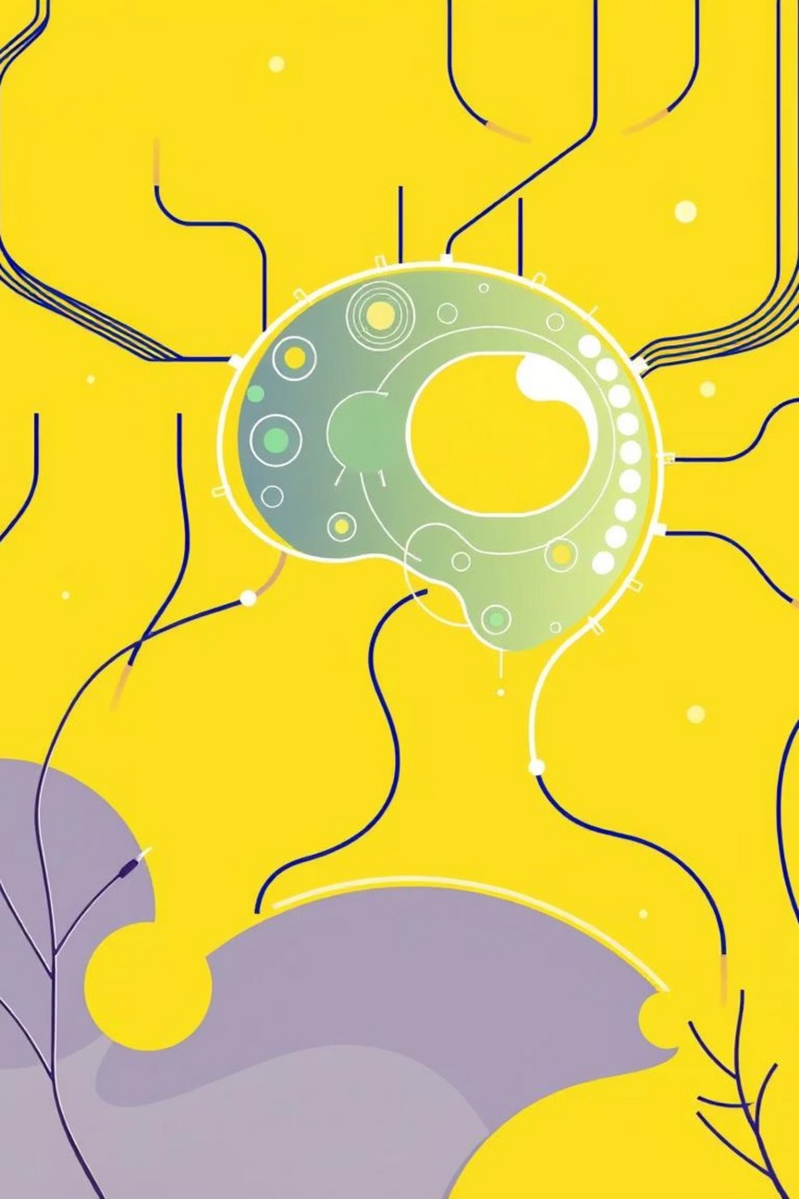

Generative AI for Youth Mental Wellness
Breaking the stigma, building support with AI.
Presented by:
Annadi Abhinaya, Sidhanthi Maukthika, Pasham Yagna Valki Gen AI Exchange Hackathon 2025

Slide 2

The Silent Struggle: Youth Mental Health in India
In India, mental health remains shrouded in societal taboo, creating immense pressure on young individuals.
Many youth grapple with academic and social pressures, yet hesitate to seek the help they desperately need.
Stigma & Judgment
Fear of being judged prevents open discussions about mental well-being.
High Cost & Limited Access
Professional mental health support is often expensive and geographically scarce.
Confidentiality Concerns
Students worry about privacy breaches if they reach out for help.
The tragic result: countless young minds suffer in silence, without timely intervention or support.

Slide 3










Our Vision: Empowering Young Minds
"Empowering young minds to seek help without fear."
Confidential & Empathetic
Building a safe space for vulnerable conversations.
Leverage Google Cloud's
Generative AI
Harnessing cutting-edge AI to create
a transformative solution.
Culturally Sensitive
Responses tailored to the unique cultural context of India.
Destigmatize Mental Health
Fostering an open environment for mental well-being discussions.
24/7 Accessible Support
Help whenever and wherever it's needed.

Slide 4
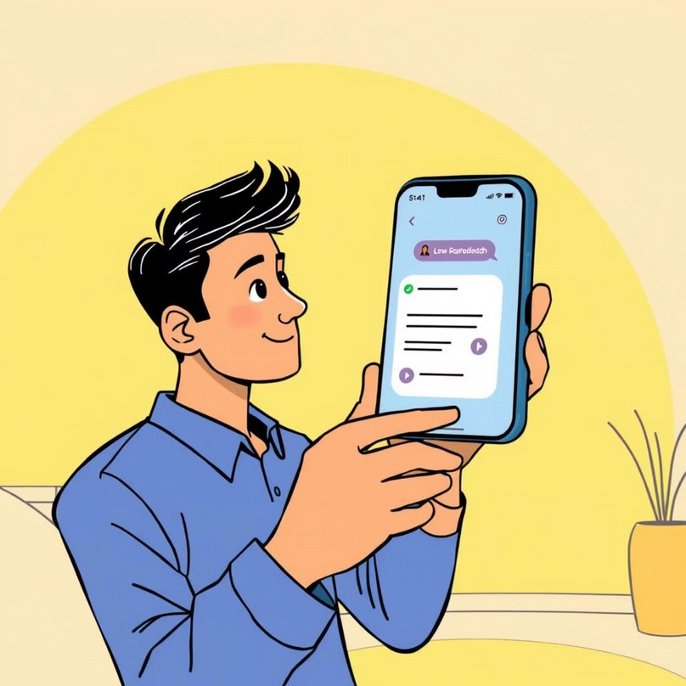
Introducing Aura: Your AI Wellness Companion
Aura is an AI-powered, confidential companion designed specifically for youth mental wellness.
1
2
Anonymous AI Chat
Interactive Psycho-education
Empathetic conversations for immediate support.
Resources on stress, anxiety, and coping mechanisms.
3
4
Mood Tracking & Goal Setting
Hybrid Escalation
Personalized nudges to cultivate positive habits.
Seamless connection to human counselors or helplines during crises.
5
Multi-language & Culturally Tuned
Aura is optimized for mobile-first access and low-bandwidth environments, ensuring broad reach across India.
Understandable and relatable responses in local languages.

Slide 5






Core Features: Designed for Impact
Culturally Tuned
U^{A}n^{I} derstands local languages, dialects, and slang for truly relatable interactions.
Confidential &
E^{S}nªs^{f}u^{e}ring privacy with on-device data handling and robust anonymization techniques.
Interactive
E^{R}n^{e}g^{s}aºg^{u}in^{r}g^{c}t^{e}o^{s}ols like stress-busting exercises, guided journaling, and mindfulness prompts.
Escalation
S^{P}wªi^{t}f^{h}tly^{w}cªo^{y}n^{s}nects at-risk users to verified human support and emergency helplines.
Personalized
I^{T}n^{r}tuªit^{c}iv^{k}e^{in}m^{g}ood logs, wellness reminders, and habit-forming nudges for sustained well-being.
Offline Access
SMS/chat-based options to support youth in underserved areas with limited internet connectivity.

Slide 6

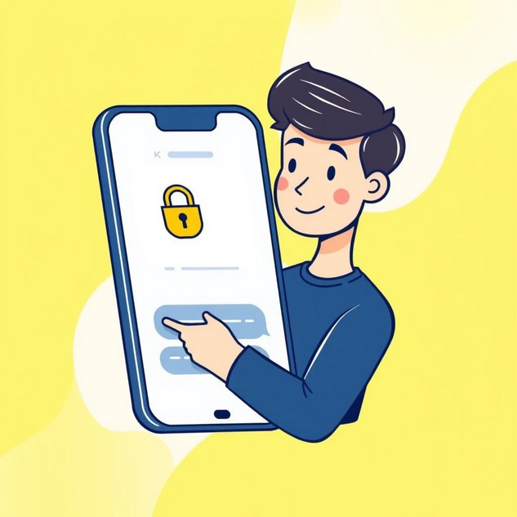
The Engine Behind Aura: Our Tech Stack
Aura leverages advanced technologies to provide a seamless and secure mental wellness experience.
Generative AI
Powered by Google Cloud's Vertex AI and state-of-the-art PaLM models for intelligent conversational responses.
Natural Language Processing (NLP)
Enabling empathetic understanding and contextually relevant dialogue with users.
Knowledge Graph & Curated Resources
Integrating verified mental health information and psycho-education for reliable guidance.
Privacy-First Architecture
Prioritizing user data security with on-device inference where possible and transparent data handling protocols.
Mobile-First Web App + Chatbot
Ensuring accessibility and ease of use across various devices.
Helpline Integration
Seamless connectivity with verified helplines and a network of qualified counselors for crisis support.

Slide 7



Transformative Impact Across India
For Youth
Provides a safe, stigma-free, and always-available channel for mental health support.
For Parents & Educators
Fosters a more supported and resilient student population, leading to better academic outcomes.
For Society
Actively breaks down taboos, promoting open conversations and collective mental well- being.
Long-Term Benefits
40%
60%
100%
Reduced Stress & Anxiety Anticipated decrease in stress levels among student users.
Higher Awareness
Increased understanding and acceptance of mental health issues.
Scalable National Impact Potential to reach millions of youth across diverse regions of India.

Slide 8
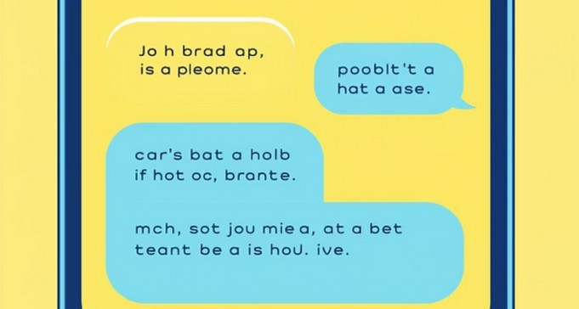
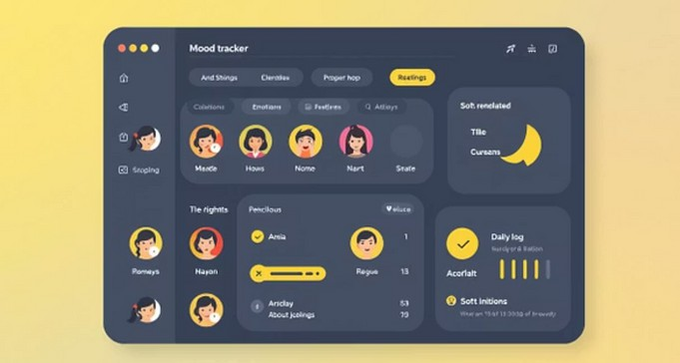
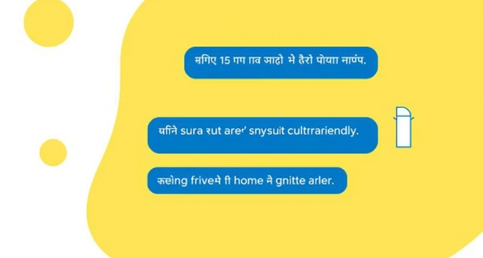

A Sneak Peek: Aura in Action
Witness the empathetic capabilities of Aura through these live demo highlights.
"Empathetic AI that listens, understands, and guides."

Slide 9

Roadmap: Scaling Our Vision
Phase 1: Hackathon Build
Prototype of the core AI chatbot and mood tracker functionality.
Phase 2: Enhancement
Integration of multi-language support and verified mental health content.
Phase 3: Expansion
Full integration with counselor networks, helplines, and mobile offline capabilities.
Phase 4: Adoption
Large-scale implementation in schools, colleges, and collaboration with NGOs across India.

Slide 10
Conclusion: A Future of Wellness
Generative AI offers an unparalleled opportunity to truly transform youth mental health care in India.
Accessible
Help, anytime, anywhere.
Empathetic Understanding and culturally tuned support.
Confidential
A safe space for every young voice.
Together, we can empower the youth of India to:
Break the stigma surrounding mental health.
Find their voice and express their struggles openly.
Build resilience for a brighter, healthier future.
"Because every young mind deserves to be heard."

